Slide 1
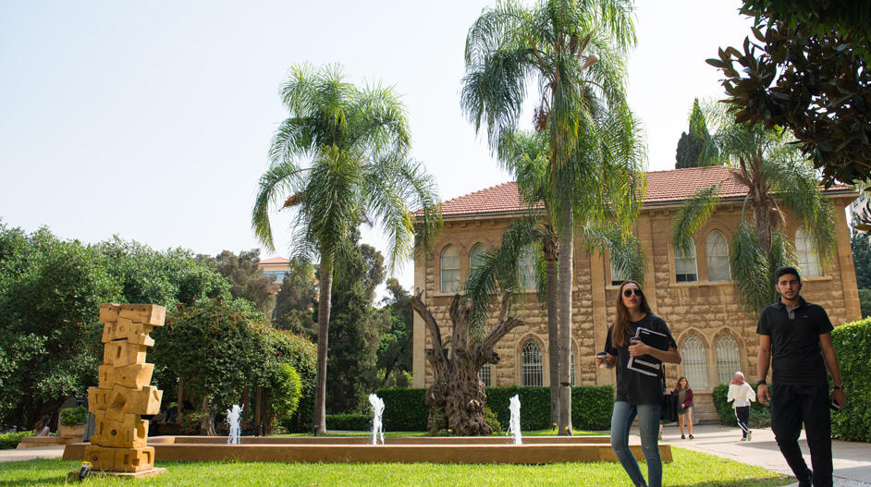


LAU Academy of Continuing Education
LAU ACE

Slide 2





LAU ACE in a Nutshell
For the past 30 years, the Lebanese American University Academy of Continuing Education (LAU ACE) division has been marshalling LAU by encompassing all schools in reaching out to communities for the purpose of adult education, professional enhancement, applied research and impact creativity. Through ACE, LAU as an institution of higher learning is committed to community engagement on the broadest scale, in the interest of sustainable knowledge driven by socio-economic developments.
32+ Years
In the field of Continuous Learning
100 Years
LAU as a leading American University in Lebanon
LEBANON-UAE-KSA-CYPRUS

